Slide 1
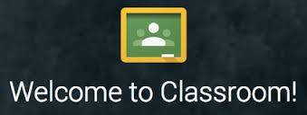
Google Classroom

Slide 2

What is Google Classroom?
Google Classroom is available to schools with a Google
Apps for Education (GAfE) domain.
Classroom is a way to get all of
your students in one place and
allows you to easily assign work
and for students to submit.
Home base for google drive.

Slide 3
Logging In
Go to https://classroom.google.com and click on the “Sign In” button.
2. Having got to Google Classroom, to sign in, students must enter their school login credentials. This is their school e-mail address and their network password.
3. Having logged in, students will be presented with all of the Classrooms that they have already enrolled onto. For a student to enrol onto another Classroom, they must click on the "+" sign at the top of the screen, followed by "Join Class".

Slide 4
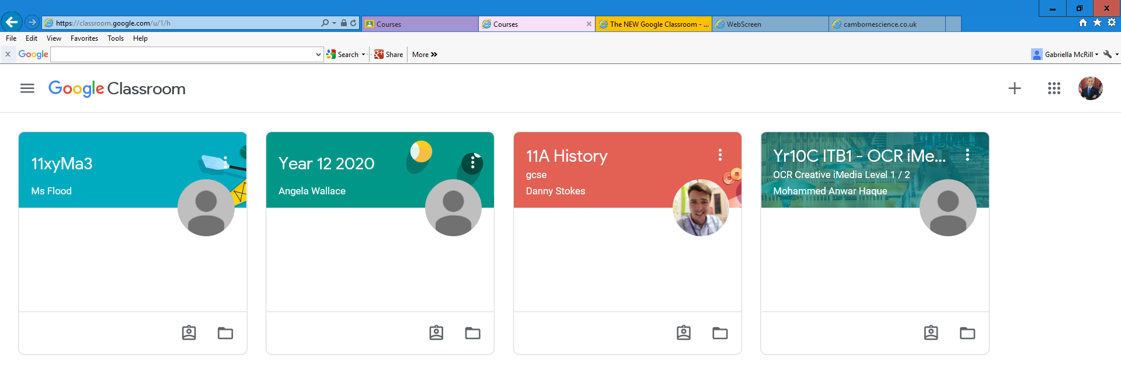
Using the Classroom Code to join:
Go to Google Classroom.
Click on the plus sign in the right hand corner.
Click join class.
Then type in the
classroom code
and click join.

Slide 5
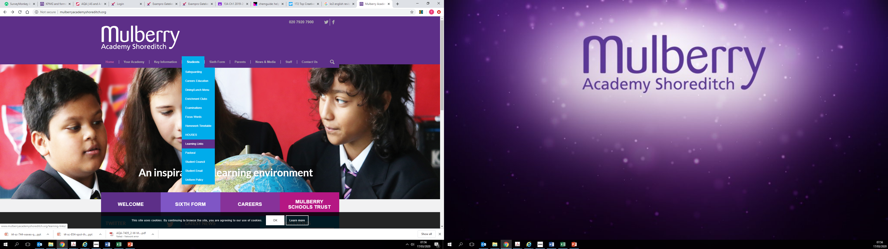

Slide 6
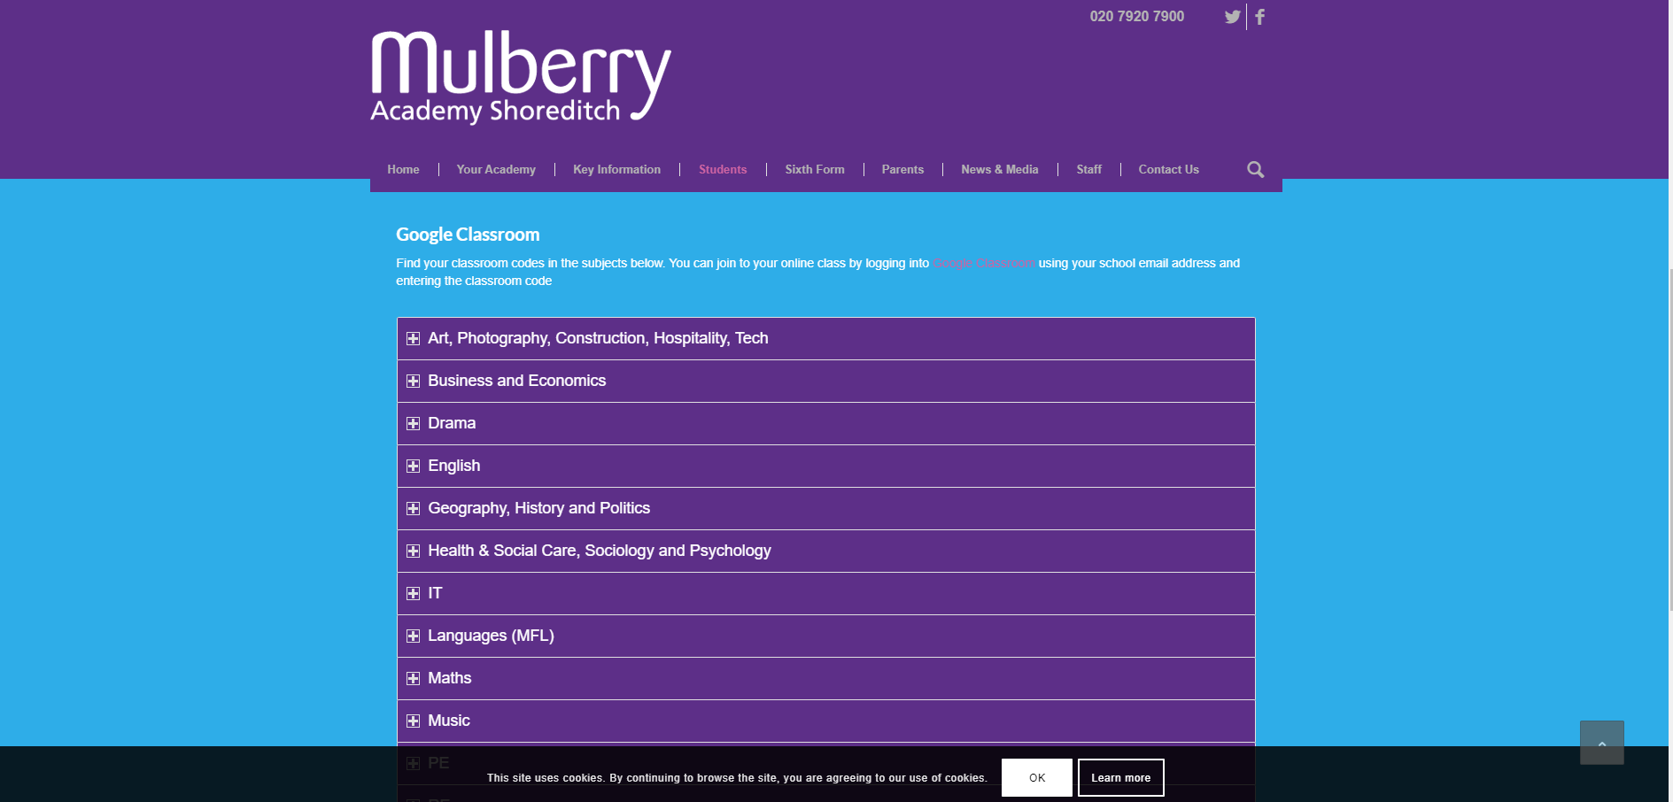

Slide 7
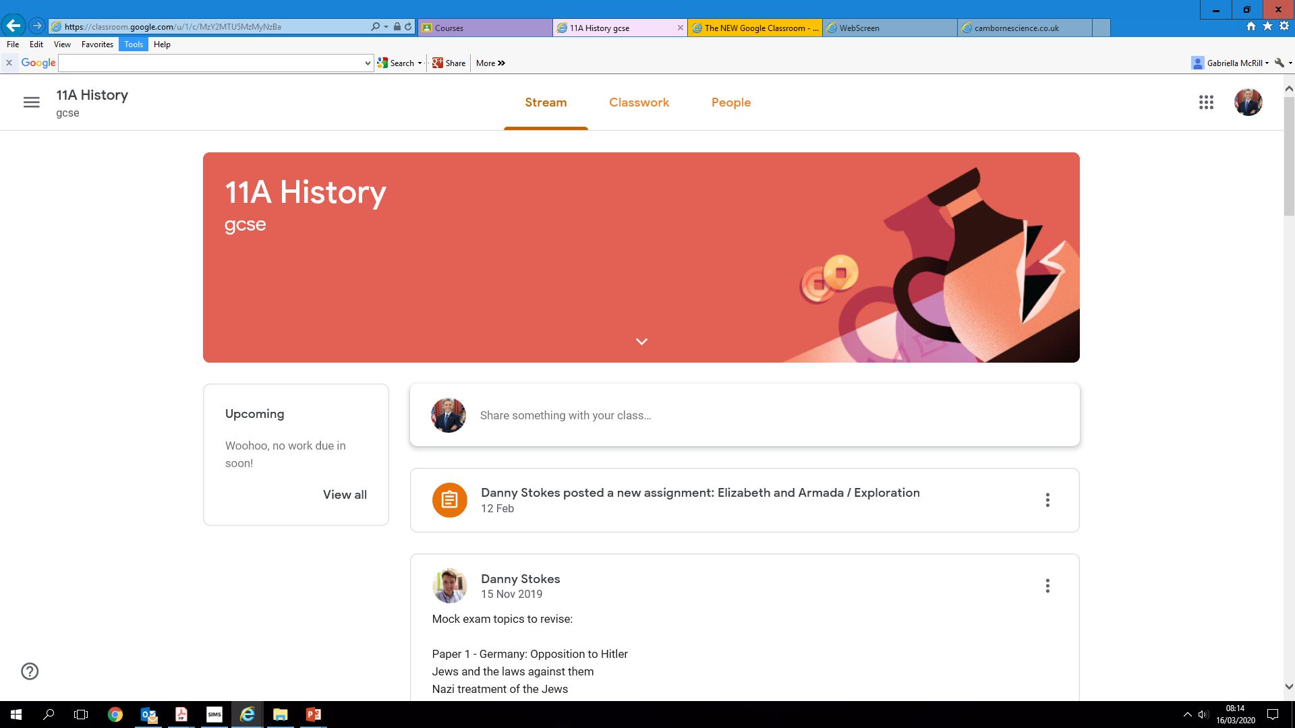
The stream works similarly to a social network page. The most recent post that a teacher has added to the Google Classroom will be at the top and the oldest will be at the bottom. Each post will be associated with the subject that the student is learning with that teacher.
When a teacher posts an assignment on their Google Classroom, it will contain the name of the task, a description of what the student has to do and possibly associated resources where possible. It will also have a due date for when the work needs to be completed by.

Slide 8
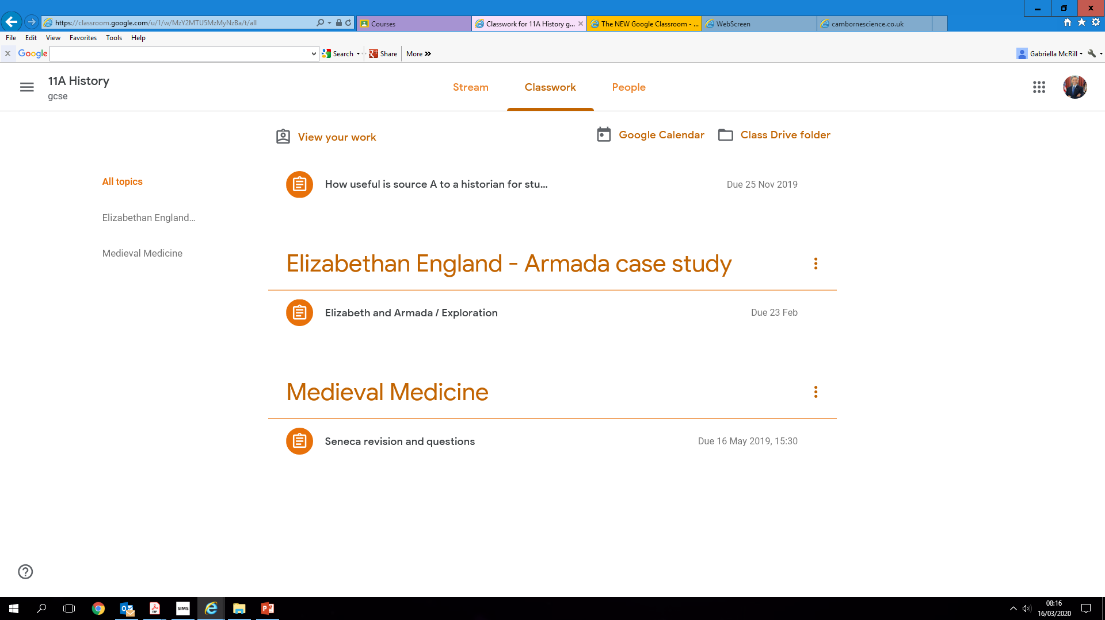
Completing/Submitting
Work Online
If students have to complete their work online, they will need to click on the name of the assignment followed by "Add +". A drop-down menu will appear where they can choose to create a Google document or upload a file from their computer or their online storage Google Drive.

Slide 9
Having added their chosen document, it will appear in the white box just above the "Add +" button.
If a student has chosen to create a new document from the "Create" section, then they simply need to click on the file and then they can start their work. The file will open in a separate tab and will save automatically until closed. The student can go back to this document to work on it as many times as they wish until they need to submit it.
After the work has been completed or added to the assignment, then the student will need to press the "Hand In" button. See image below.

Slide 10
Mobile Apps
You can download Google Apps for your handheld device. They are free but you must remember to use your school login details. Inside each app, they will give the user the choice on which to use.
The recommended apps are the following:
➢ Google Classroom
➢ Google Drive
➢ Google Docs (free alternative to MS Word)
➢ Google Slides (free alternative to MS PowerPoint)
➢ Google Sheets (free alternative to MS Excel)

